Slide 1


Slide 2

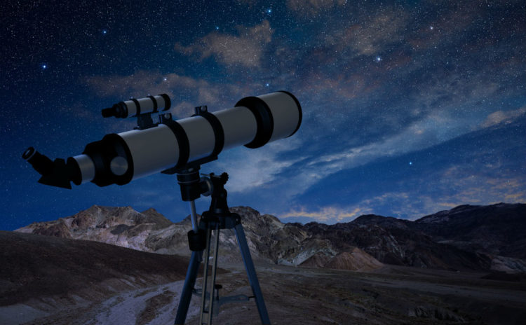
What this course is all about?
(scopetheuniverse.com 2019)
Computer science is no more about computers than astronomy is about telescopes. - Michael Fellows

Slide 3
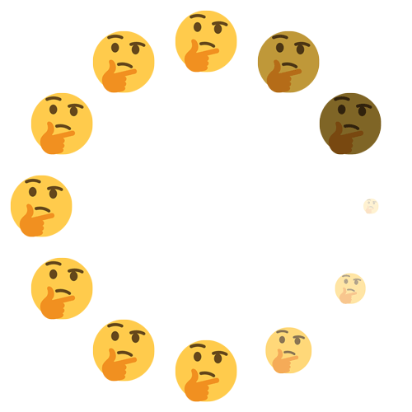
Why should you learn programming?
Self-learner’s advantage: tons of material in internet
Gaining problem solving and thinking skills
Becoming more efficient and productive
Combining technical skills with creativity
Understanding how software works
Freedom and flexibility in life
Improving your communication and collaboration skills
Becoming self-employed, starting your own business or work as freelancer
Improving your portfolio
(imgur 2019)

Slide 4
What we’ll learn
Structure of the course
We will cover following topics:
Syntax
Files System
Version Control
Best Coding Practices
Variables
Python Objects (List, Dictionary, Tuple, Sequence, Set)
Control Flow (Boolean Expressions/Operators, If, Else, Else If)
Loops (For, While),
Functions
Classes
Matlab Introduction (optional)
16 Lectures

Slide 5
Grading
Assignments
Short quizzes at the start of the class about previously discussed topics
Coding assignments at the class
Project made in groups -
30%
50%
20%

Slide 6

Assignments
Made during the lecture before break
Will be done in Microsoft Visual Studio Code
Submit Python file (.py extension)
Submited via Github, assignments folder
Deadline: Next week
Will be evaluated by following criterias:
Runs without exceptions
Code is easy to read
(imgflip 2019)

Slide 7

Final project criteria
Should be submited as Python file → No report needed
Group of 3 – 4 students
Deadline: 15.02.2020
Will be evaluated by following criterias:
Creative idea, which is interesting for everybody. Useful for your studies, hobby or everyday life.
Code is easy to read and maintain
If used Github or Stackoverflow code must be changed for your needs. NO COPYPASTING!
(meme-arsenal.com 2019)

Slide 8

Let’s start from scratch
What is language?
The system of communication in speech and writing that is used by people of a particular country or area. (Oxford dictionary 2019)
(medium.com 2019)

Slide 9

Let’s start from scratch
What is computer language?
A system of precisely defined symbols and rules devised for writing computer programs.
Therefore…
Language to talk to a computer
(interestingengineering.com2019)

Slide 10

What is python?
Interpreted
Object oriented
is …
High-level
Dynamic

Slide 11

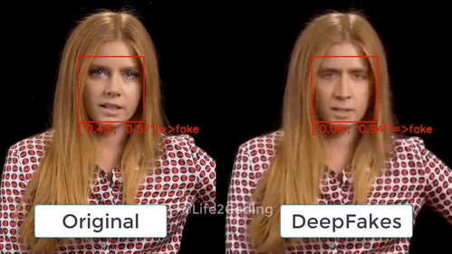
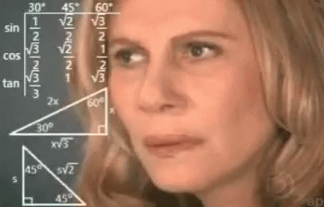
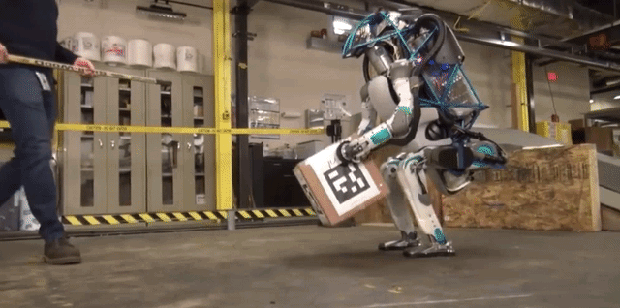
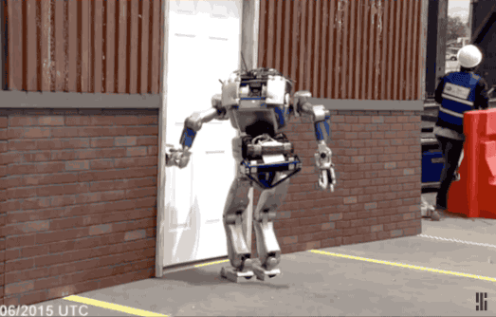
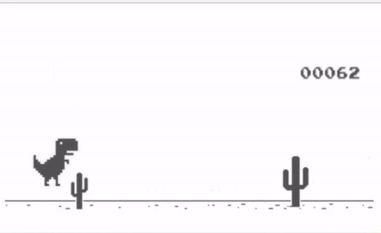
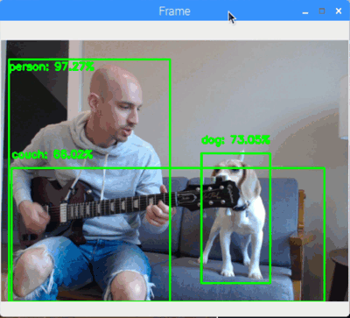
Where python is used?
Web development
Machine learning
Data science (analysis/visualization)
Robotics
Games (for easy ones)
Machine vision

Slide 12
End of introduction

